Slide 1
FITNESS WORLD MANAGEMENT SYSTEM
Submitted By: Ayerish Thakur
Submitted To: Mr. Rafeeq Qureshi
Roll No.: 2010991842
College: Chitkara University, Punjab

Slide 2
Acknowledgement
I would like to express my special thanks of gratitude to my teacher Mr. Rafeeq Qureshi who gave me the golden opportunity to do this wonderful project on the topic . Management System, which also helped me in doing a lot of Research and i came to know about so many new things I am really thankful to them.
Secondly i would also like to thank my parents and friends who helped me a lot in finalizing this project within the limited time frame.

Slide 3
Introduction TO FITNESS WORLD Management System

Slide 4
Features
Basically this website consists of users applying for fitness membership in the Fitness World Gym.
This website also tells about the benefits of working out.
It is Admin page web Application.
This Web App consisting of CRUD Operation.

Slide 5
Now Let’s Go Around With Fitness World MANAGEMENT SYSTEM
Home Page
About Us
Contact us
Form Page
Add User

Slide 6
Home Page
-It contains information about various fitness programs provided by the gym.

Slide 7
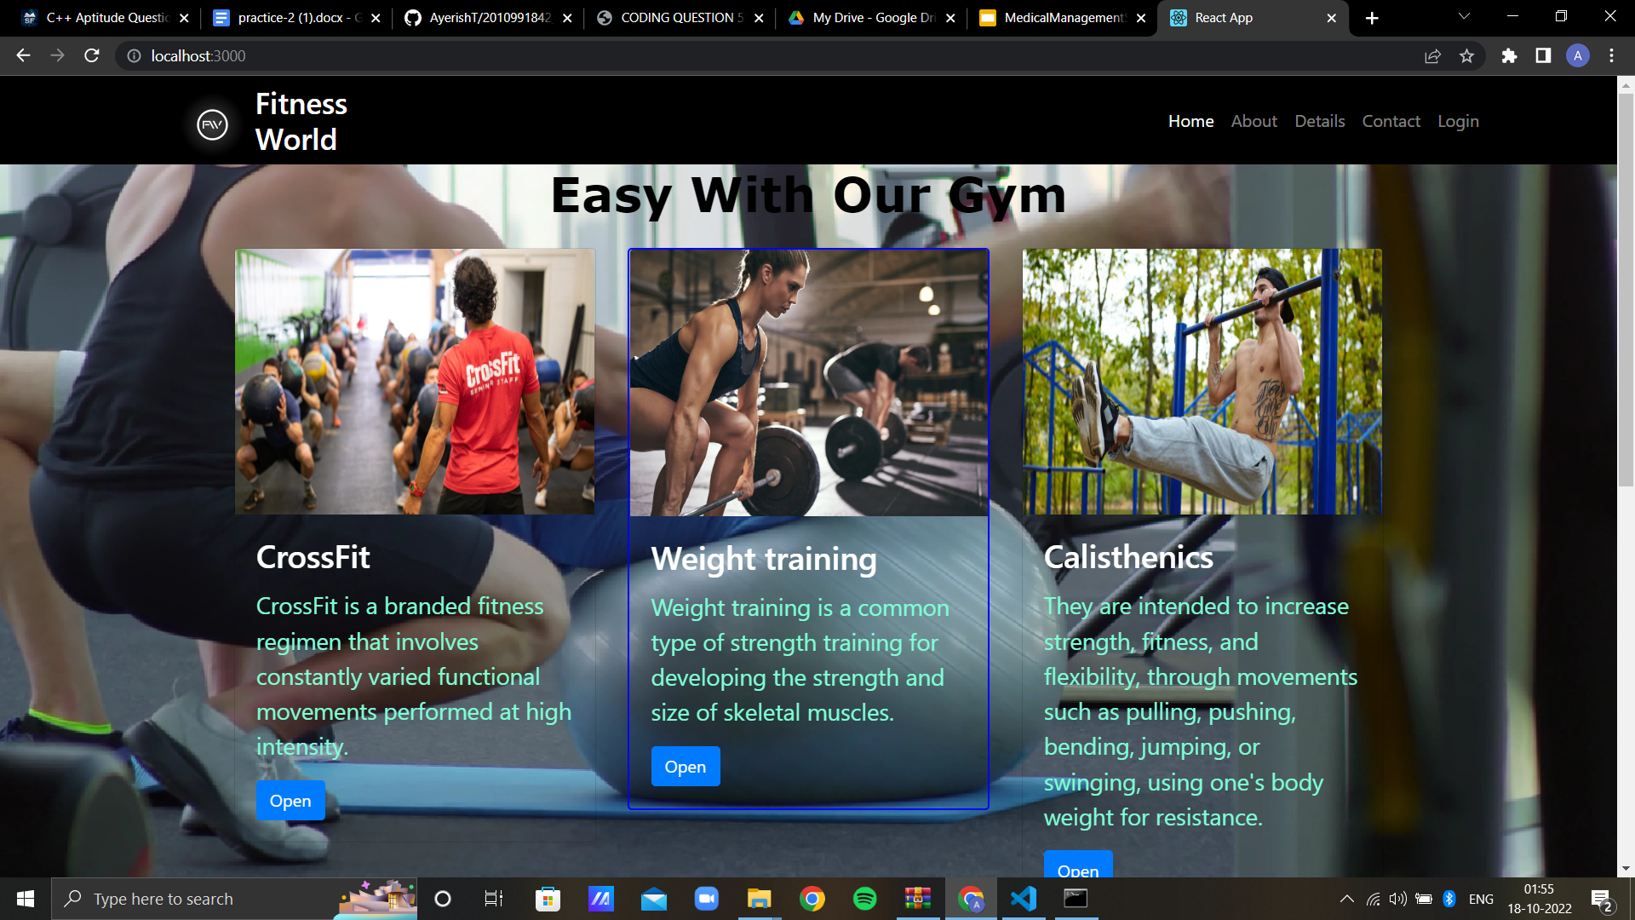

Slide 8
About Us….
This page contains information about various facilities provided by the gym.

Slide 9
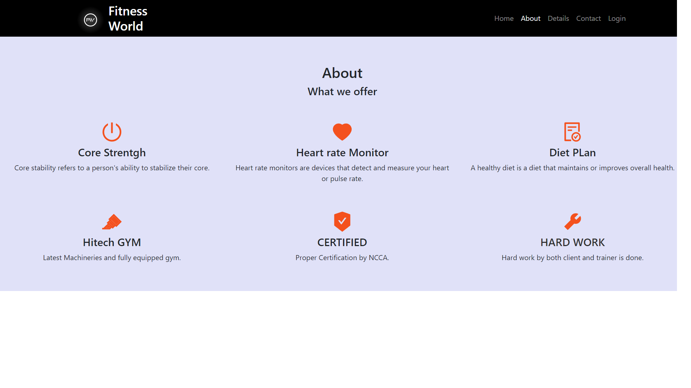

Slide 10
Details
It contains information about the users who have enrolled for the membership.

Slide 11
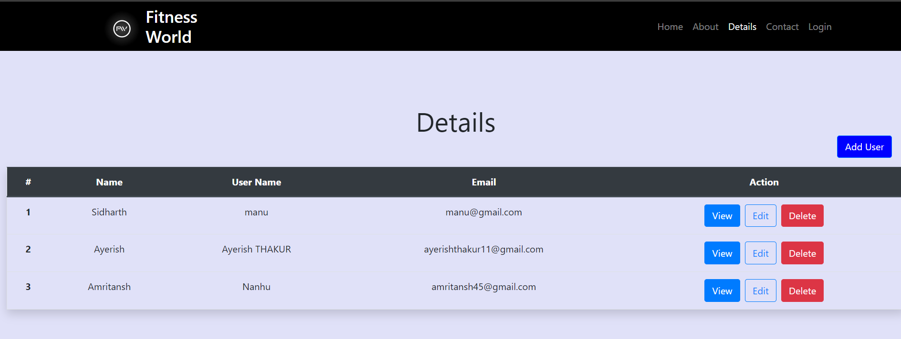

Slide 12
Contact Us…

Slide 13
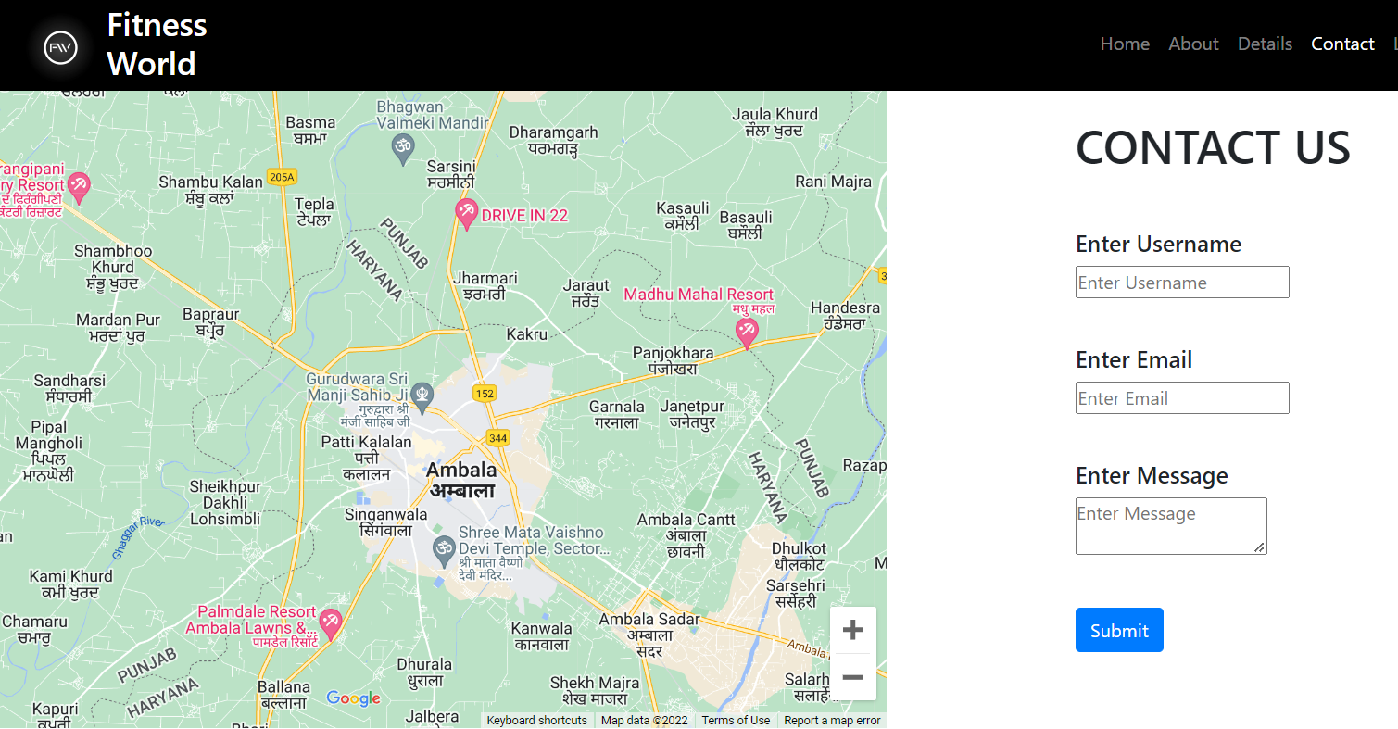

Slide 14
Add a User…

Slide 15
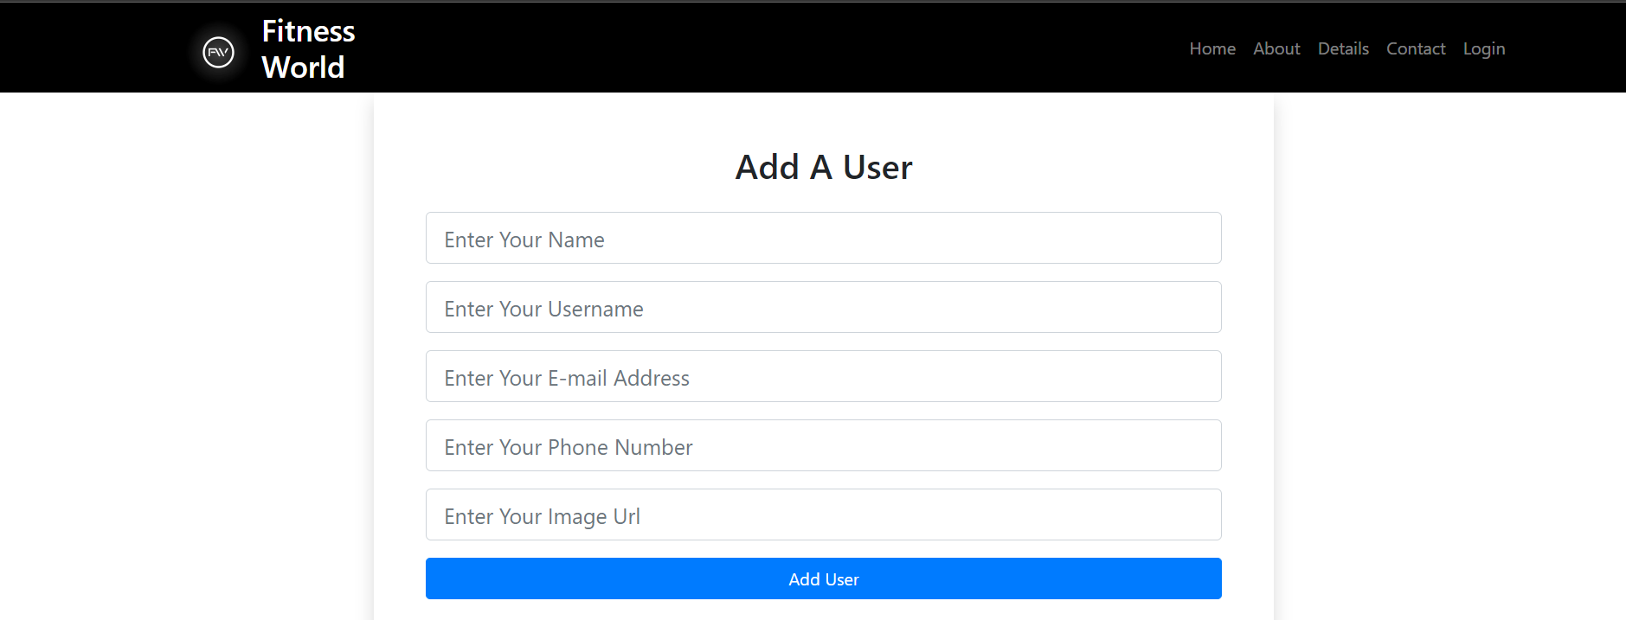

Slide 16
About Project
This project is based on Gym enrollment Management system. My Web App name is FITNESS WORLD. It is just five page component application that are: Home, About , Details,Contact Us, , Login.
React is a declarative, efficient, and flexible JavaScript library for building user interfaces. It lets you compose complex UIs from small and isolated pieces of code called “components”.
For navigating from one page to another we just use routing.
In the Contact Us Component we just made the form and imported Map. If the user submit the form there we just received the confirmation that the user submitted this form.
In the Details Component we just shown the information of users who have enrolled themselves and according to that admin can view that particular page information, Edit that particular user’s Information, Delete that particular user’s information.

Slide 17
Use of CRUD OPERATION
I just use the CRUD operation for adding, reading, updating and deleting.
CRUD stands for Create, Read, Update, and Delete. In Reacts everything is aligned in a form of a component and every component has its own way and feature to do so.
React jess is one of the most used JavaScript libraries for frontend development. It’s very important to have the basic functionality of CRUD operations in with react-jess. In this article, we don’t use any JSON-server or Axioms for performing the CRUD operation. We will use a simple JavaScript object to do so.
Create: Creating a post or adding the table row, adding data into the webpage, or creating content.
Read: Reading or retrieving data from web-page
Update: Updating or editing existing content in the webpage
Deleting: Deleting and removing the entry or content/post from the webpage

Slide 18
Refrences
React Js: https://reactjs.org/
Bootstrap: https://getbootstrap.com/
W3School: https://www.w3schools.com/
Stack Overflow: https://stackoverflow.com/

Slide 19
THANK YOU……

